Slide 1
Simple Rules

Slide 2
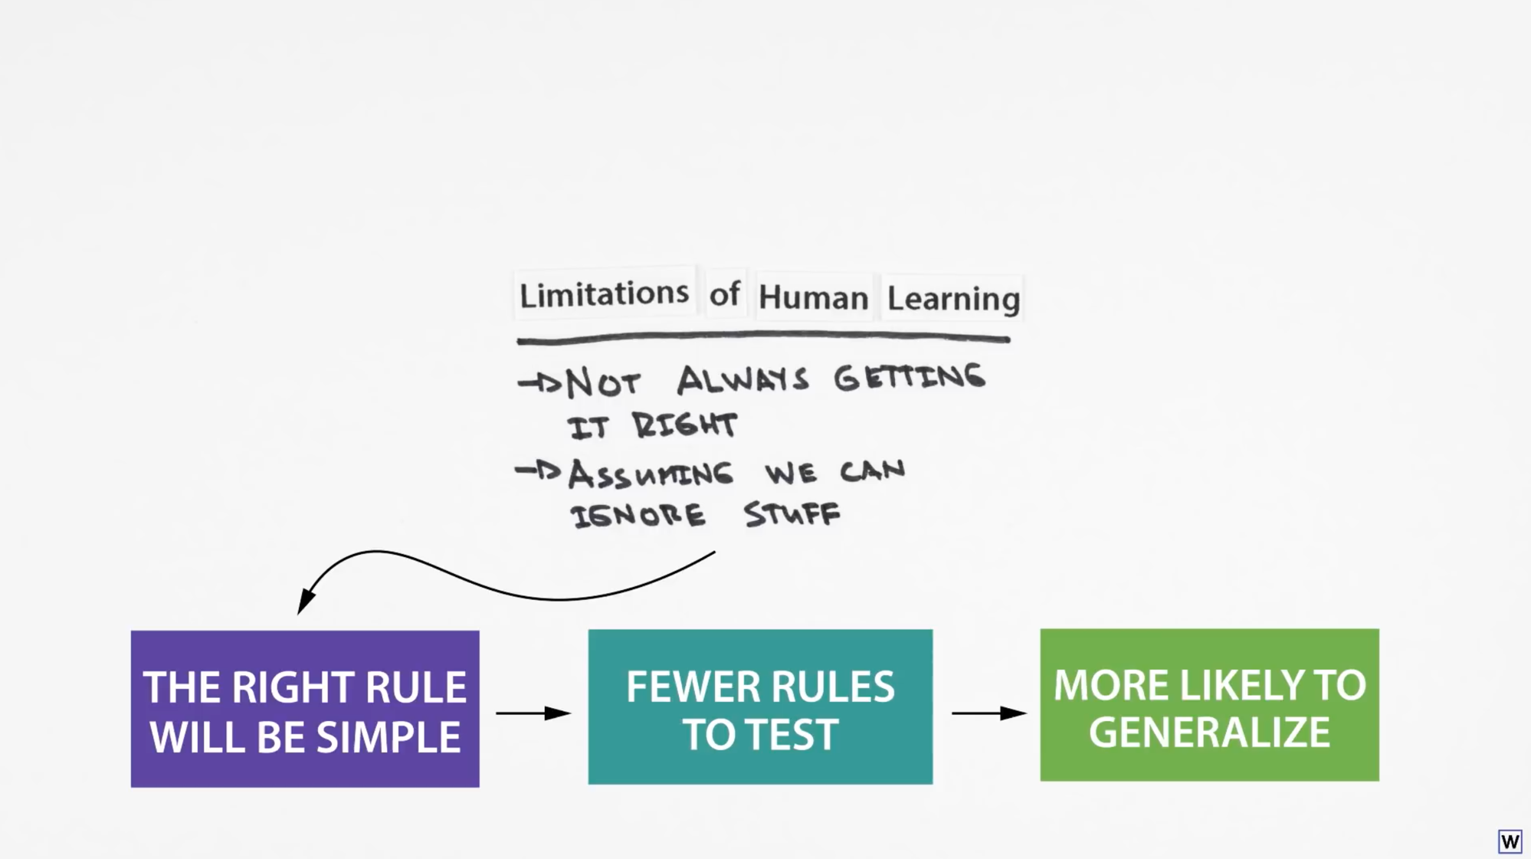
Notes:
Last time we developed a hunch that simpler rules may generalize better.

Slide 3
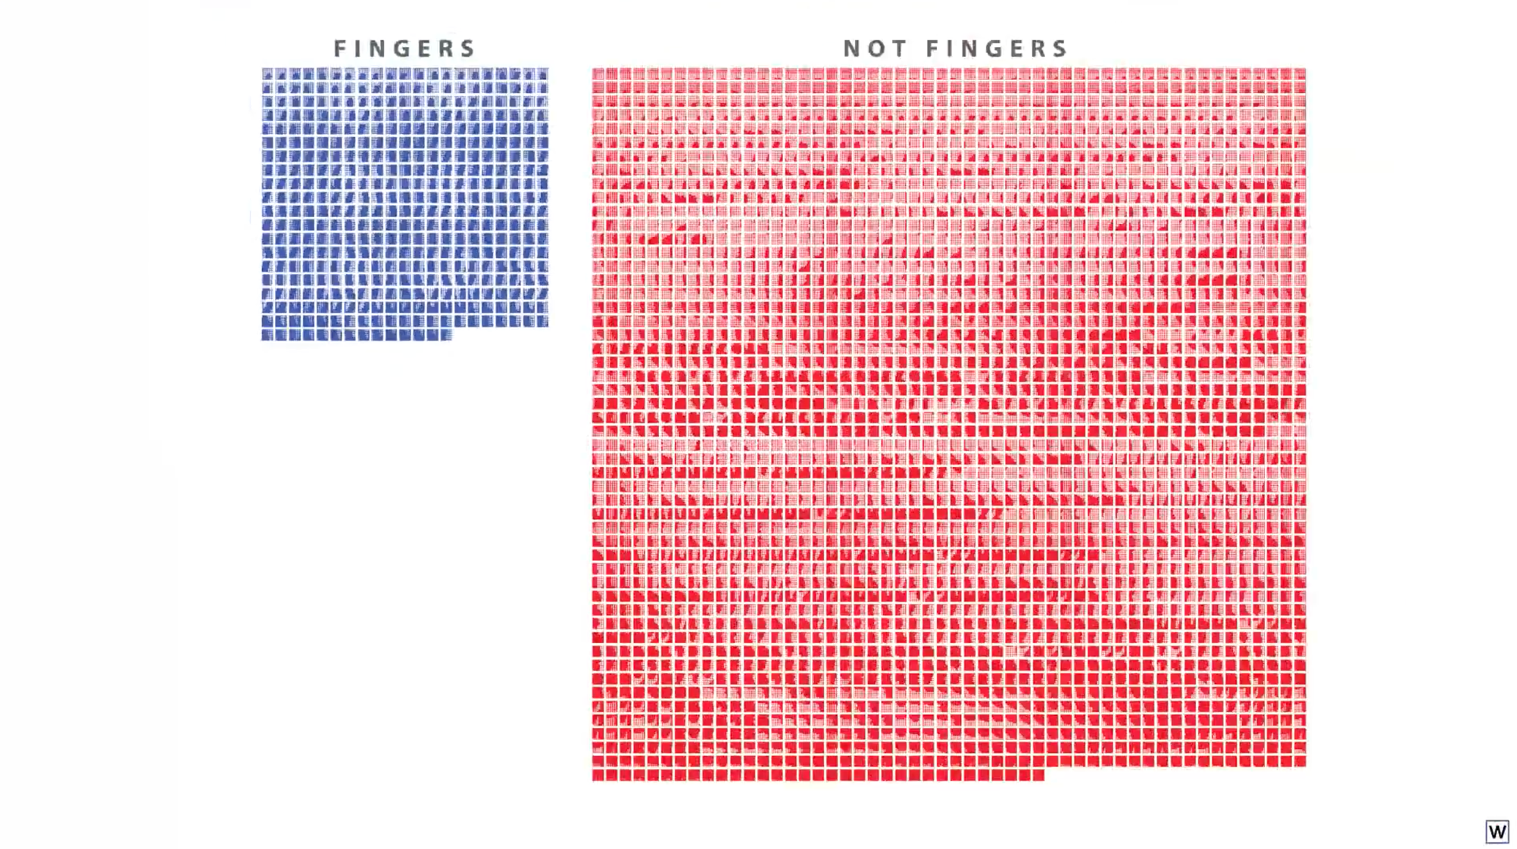
Let’s move back to our real data, and see if this “simple rule” idea works.

Slide 4
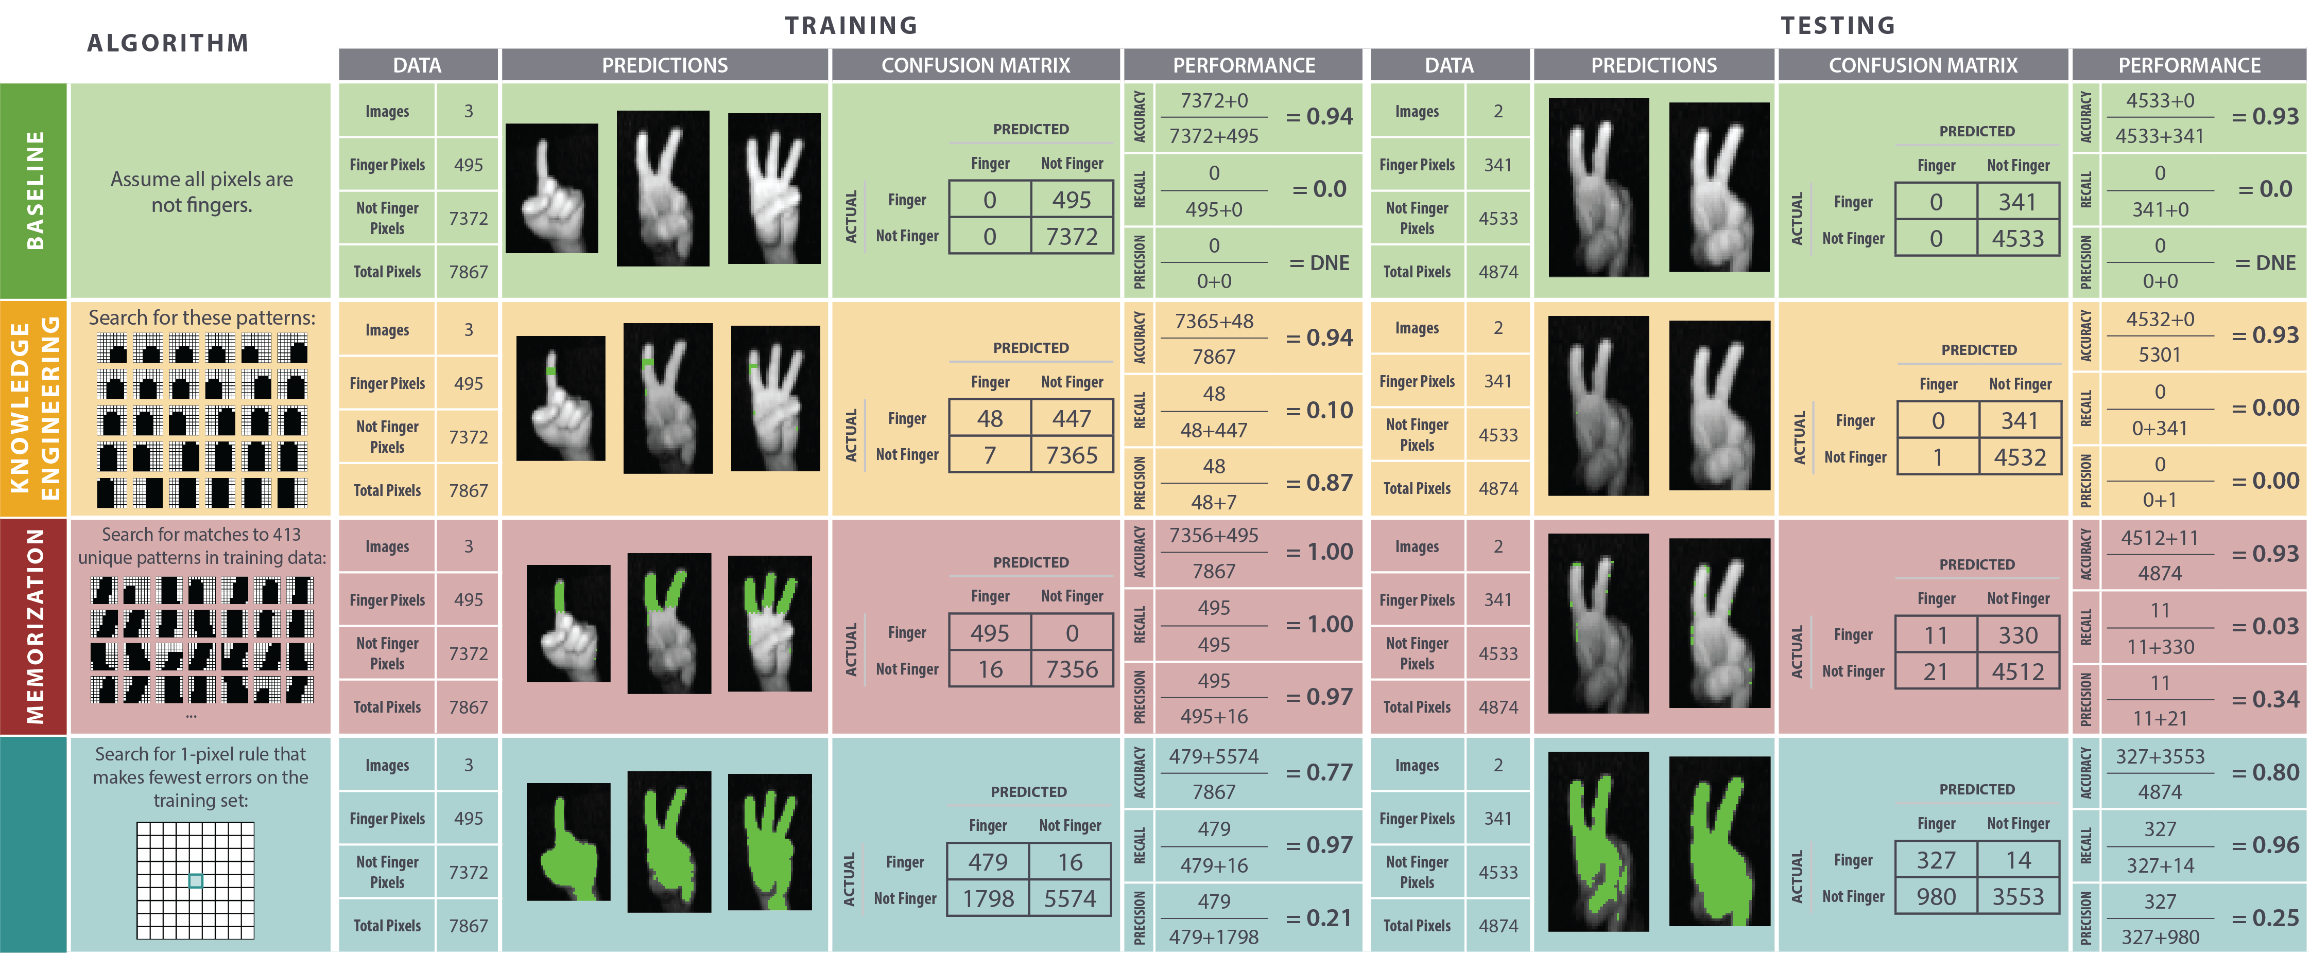
Let’s think about our approaches to learning thus far in terms of what we learned last time.

Slide 5
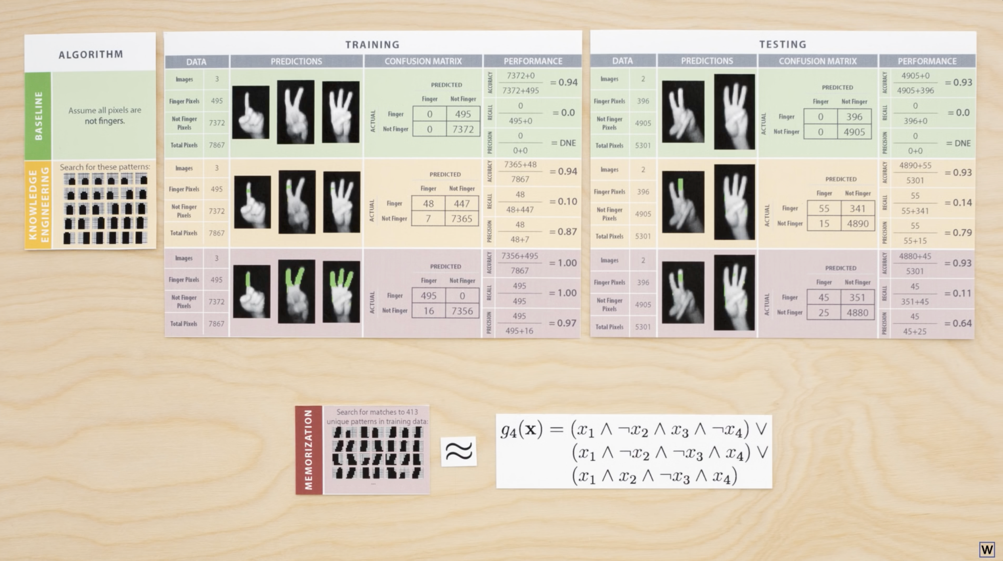
Notes:
Our memorization approach is very similar to our complex rules appraoch from last time.

Slide 6
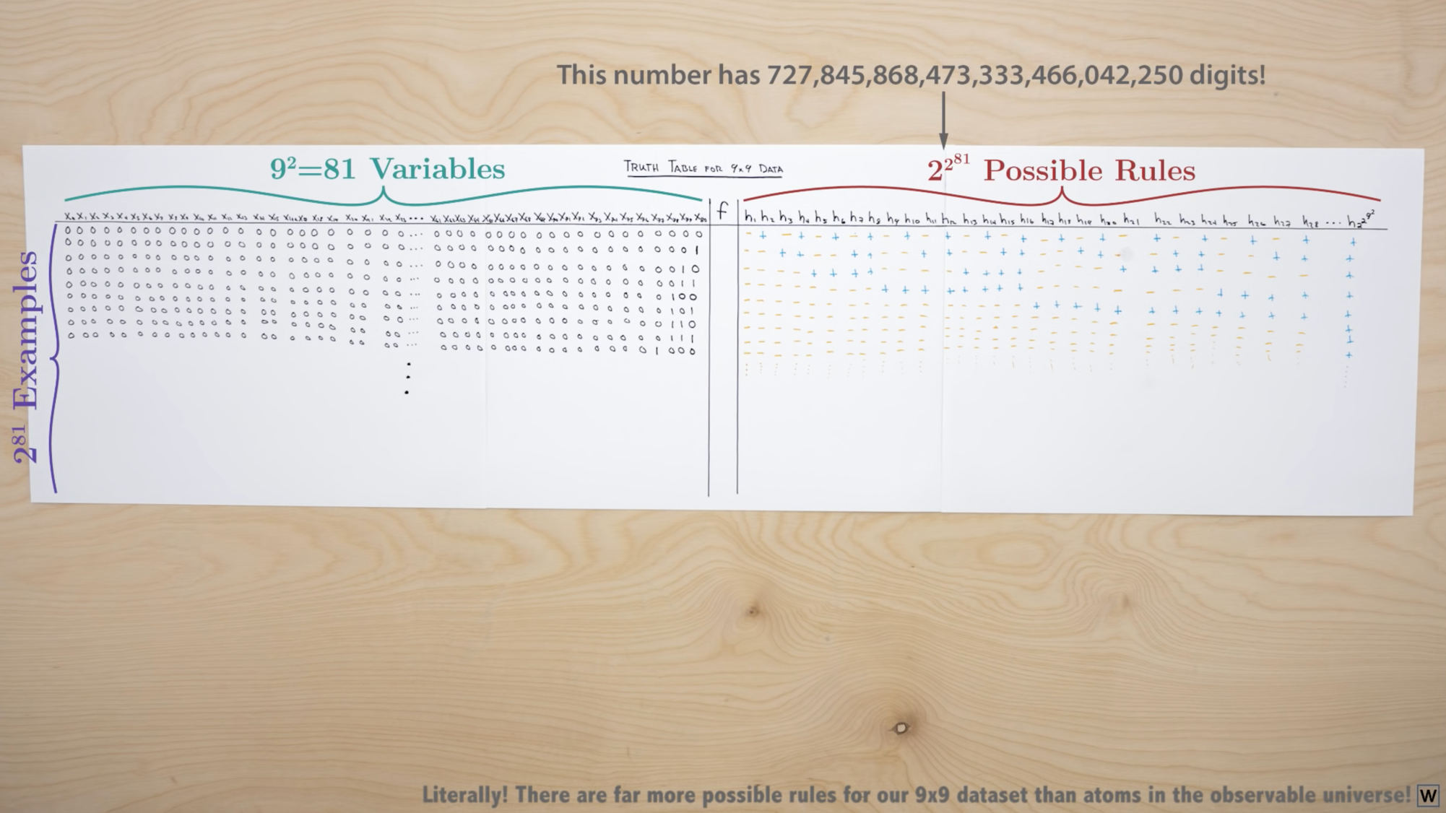
Notes:
Except for our 9x9 grids there an absolutely astronomical number of unique possible rules!

Slide 7
Now, notice that our baseline approach does generalize well.
Notes:
This fits in with our hypothesis here that simple rules will generalize better. Our baseline is super simple!

Slide 8
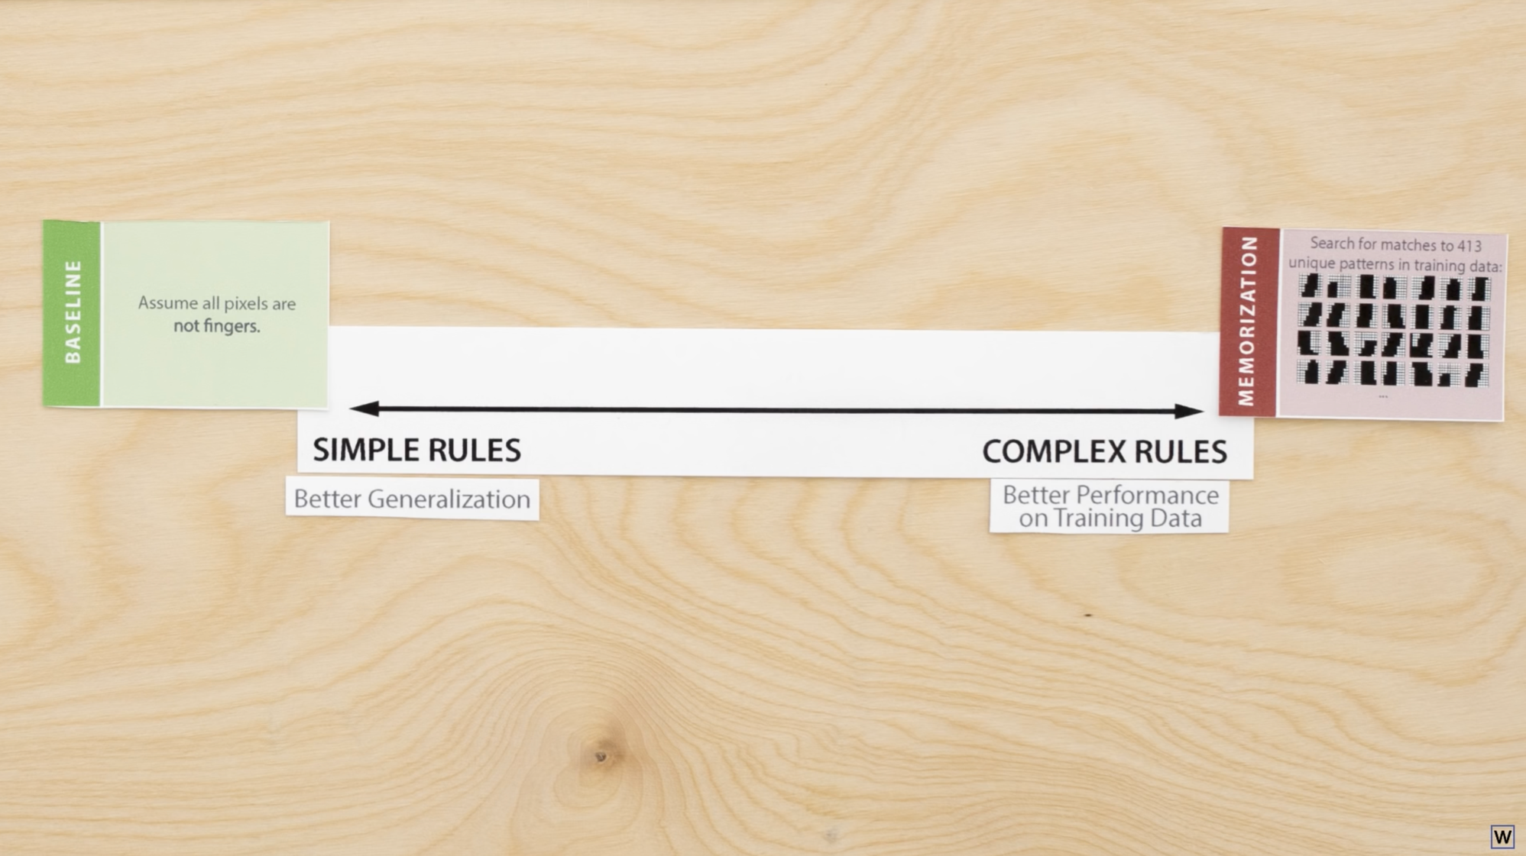
One way to think about our baseline and memorization approaches is as 2 ends of a spectrum.

Slide 9
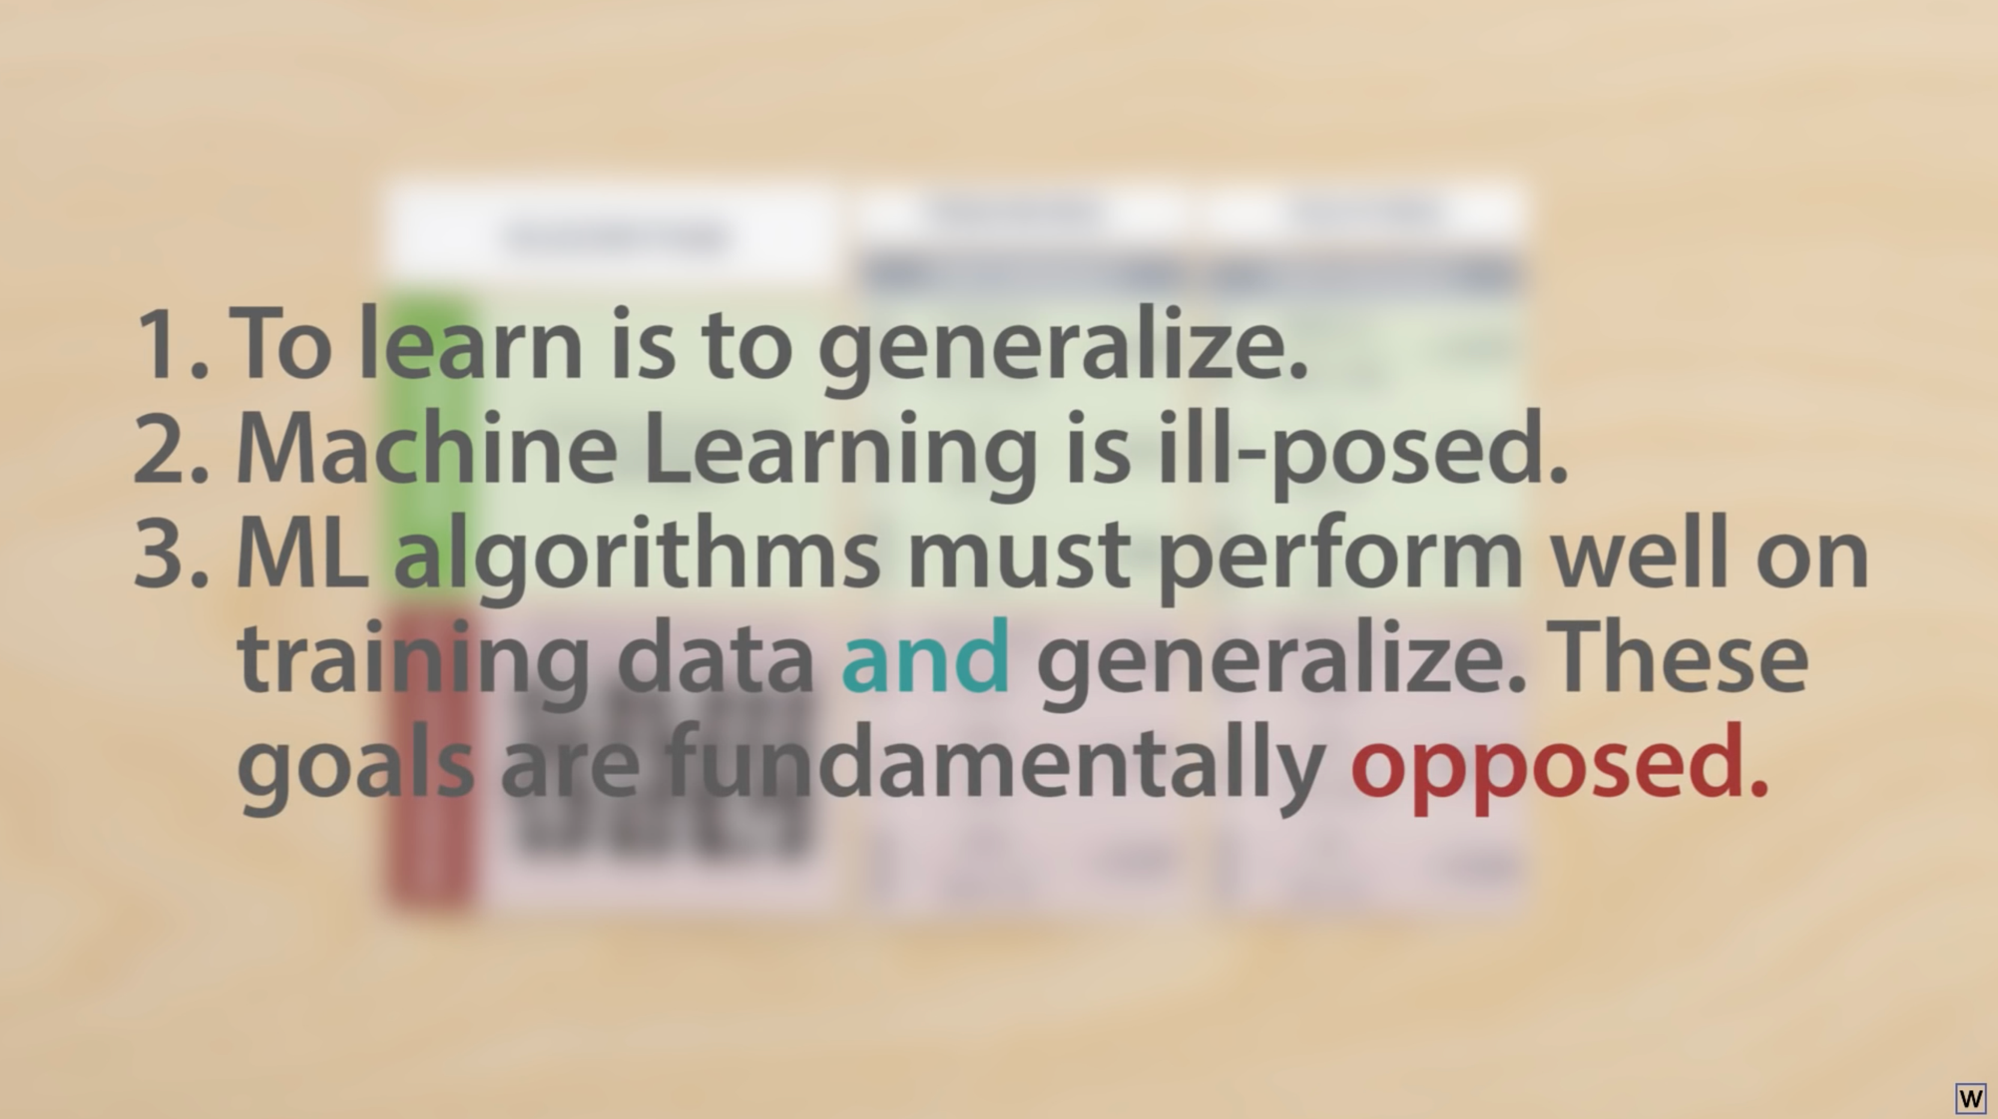
Notes:
This leads us to our third big point about ML.

Slide 10
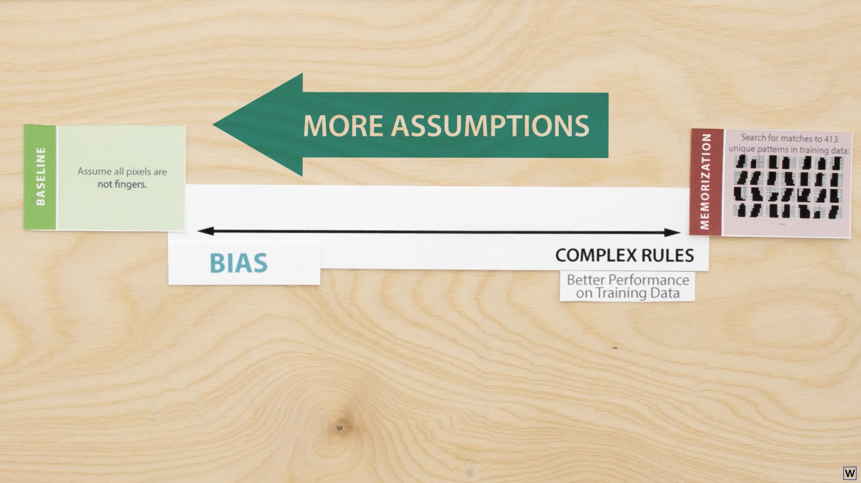
Simpler solutions make more assumptions about the final form of the solution, these assumptions are called bias.

Slide 11
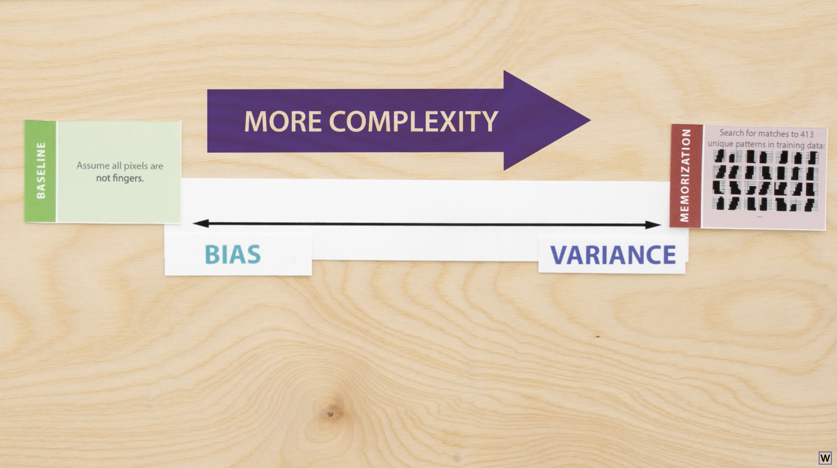
More complex solutions make fewer assumptions about the final form of the solution, and are more complex. This complexity is often called variance.

Slide 12
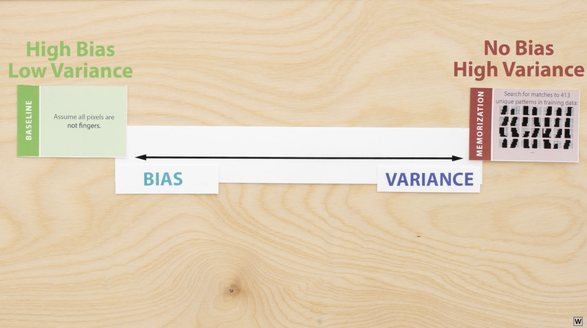

Slide 13
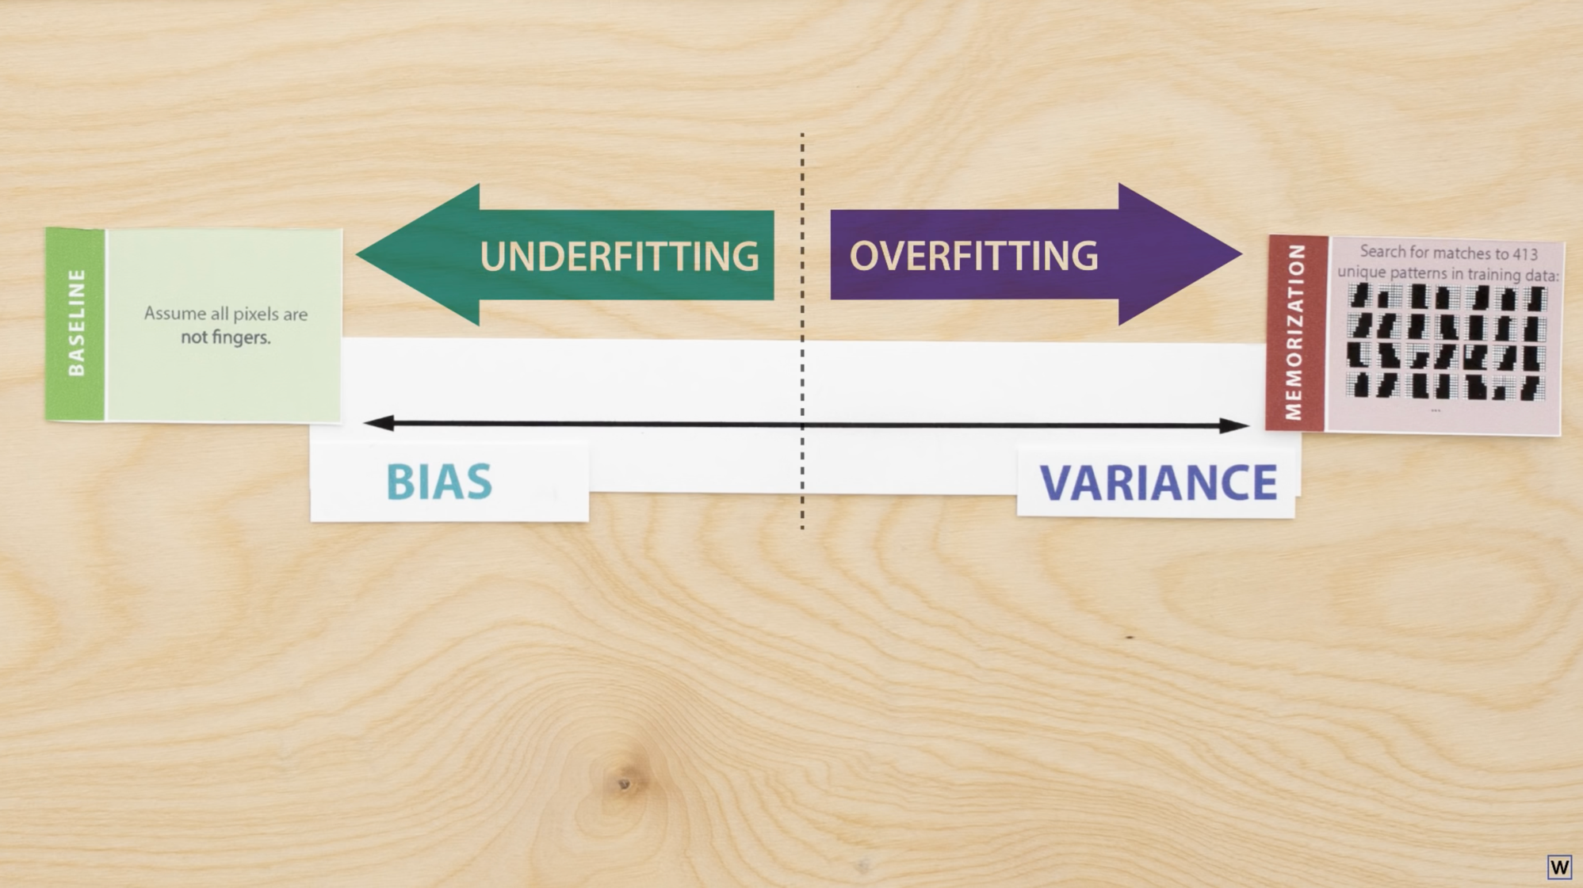
Machine Learning is about balance. If you ignore this, you’re probably doing it wrong.

Slide 14

Let’s take one baby step this way by considering rules to classify finger pixels that only use one of the pixels in our 9x9 grids.

Slide 15
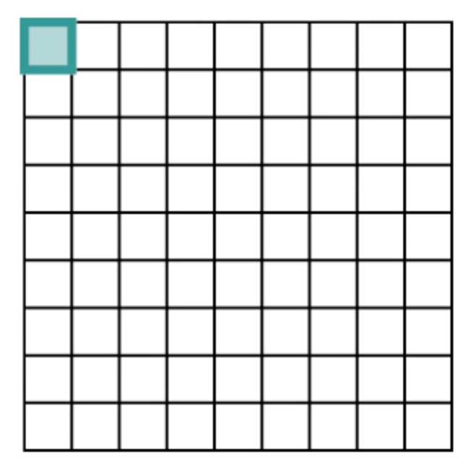
How unique many 1-pixel rules exist for our 9x9 binary grids?
81
2⁸¹
162
324
2*2⁸¹
(here’s one)

Slide 16
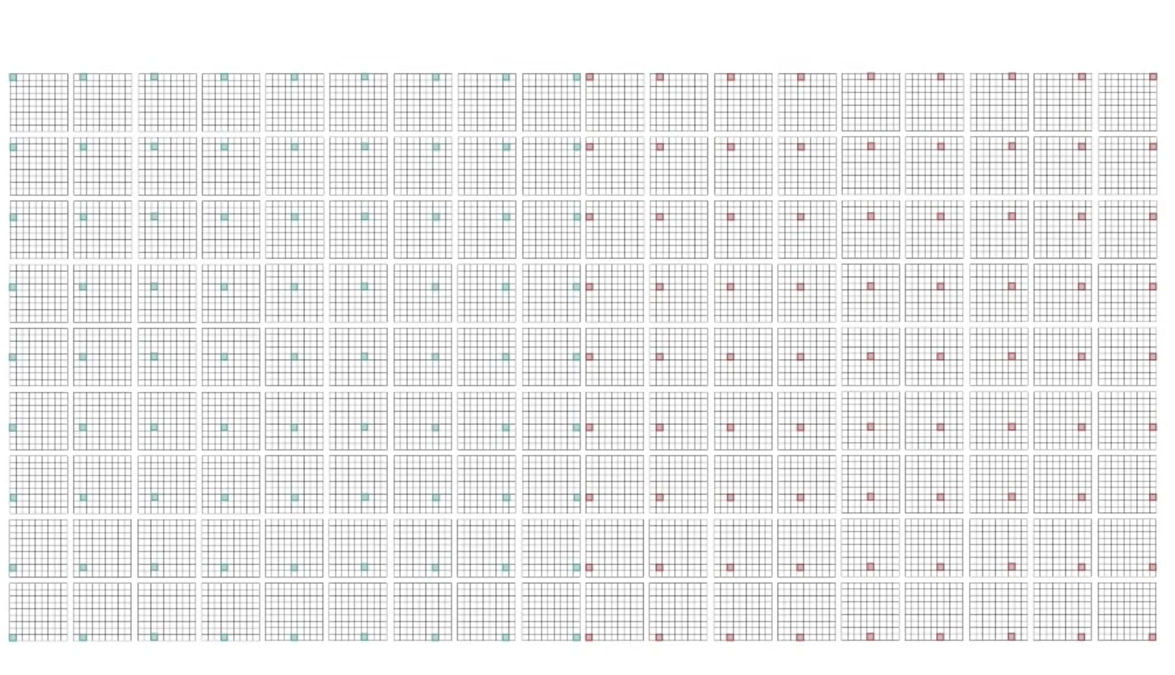
Lightning Programming Challenge 1!
Please open up the simple rules lightning programming challenges notebook in the learning to see repo.

Slide 17
…

Slide 18
Ok, performance isn’t amazing, but at least in generalizes pretty well! You can probably guess what’s next…

Slide 19
Lightning Programming Challenge 2!

Slide 20
…

Slide 21
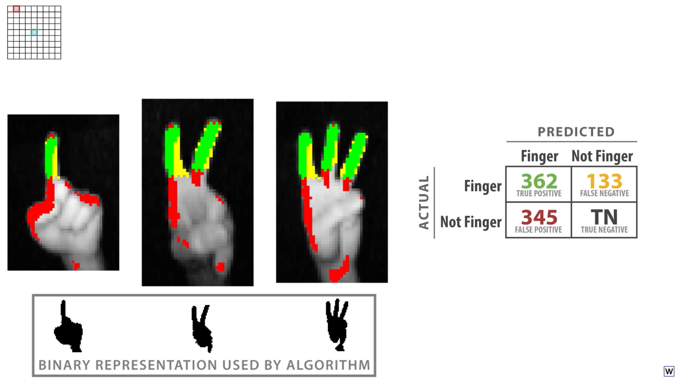
Training data was different, but the challenge 2 may have resulted in something like this. How would you describe this rule?

Slide 22
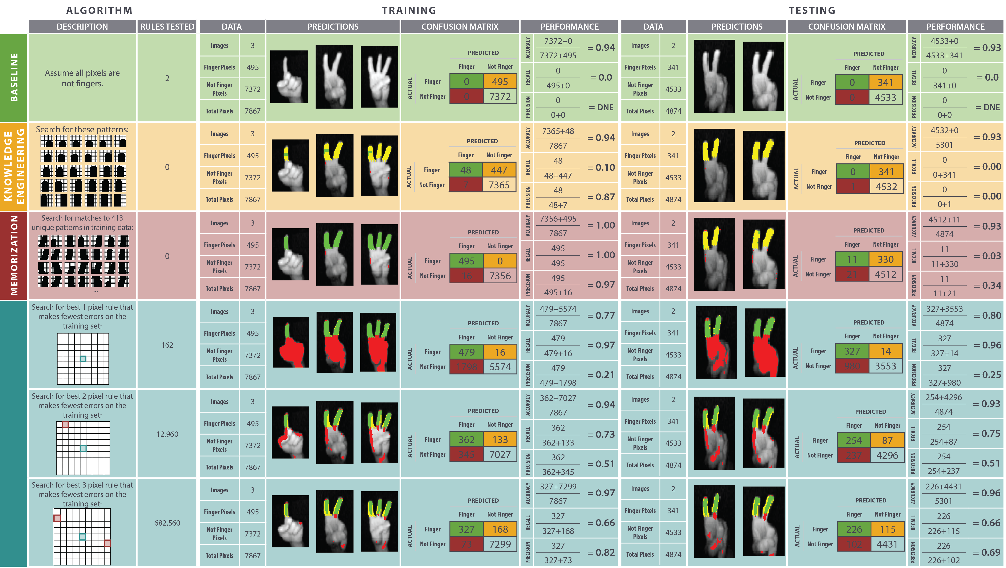

Slide 23
Lightning Programming Challenge 3!

Slide 24
…

Slide 25
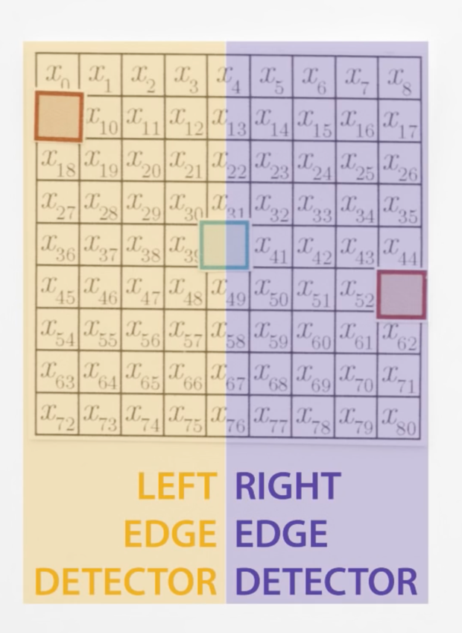
Training data was different, but the challenge 3 may have resulted in something like this.

Slide 27
Lightning Programming Challenge 4!

Slide 28
…

